Slide 1

SDHD Project Review
Motion Detection
Prof. S Bannwarth
Group A5
Aman Chauhan | 1127928
Soumya Saxena | 1127997

Slide 2
CONTENT
Overview Lab 01-02 : Hardware Implementation Lab 03-04 : Software Implementation Lab 05 : FFT Analysis (PSOC and MATLAB) Lab 06 : PCB+CW-RADAR Analysis and CFAR Implementation Q&A

Slide 3

Overview
Tx wave
CWR
Amplifier
+
Filter
ADC
FFT
CFAR
Rx wave
TARGET
On PCB
On PSOC
On MATLAB

Slide 4
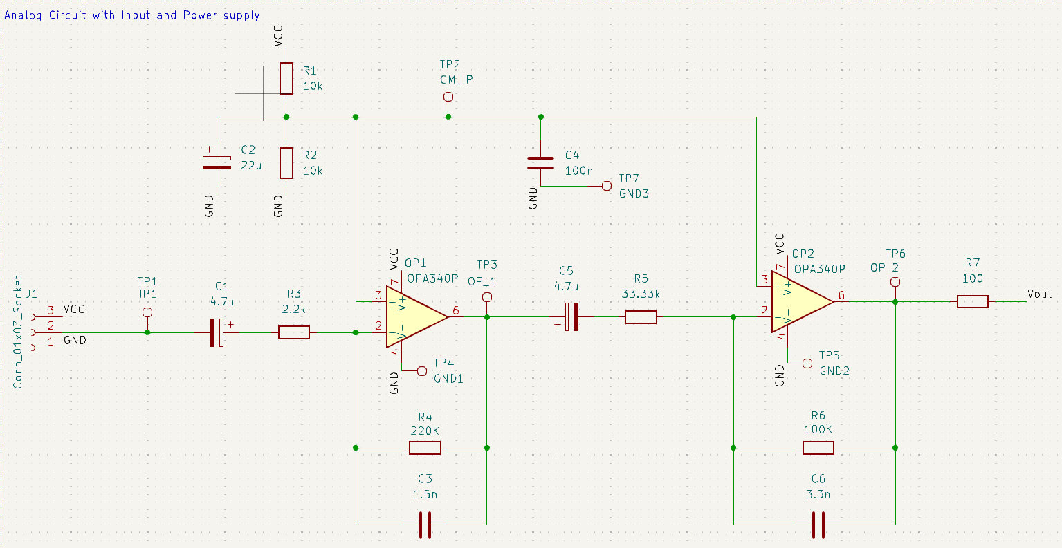
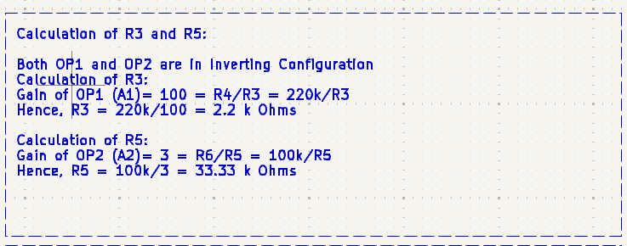
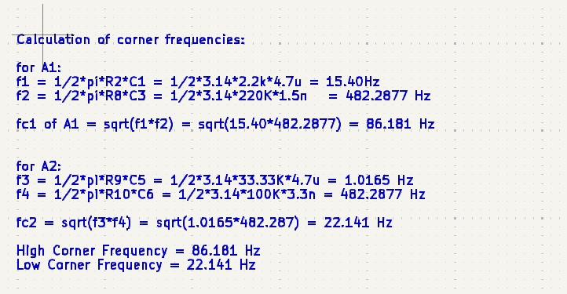
Lab01-02 (Hardware)

Slide 5
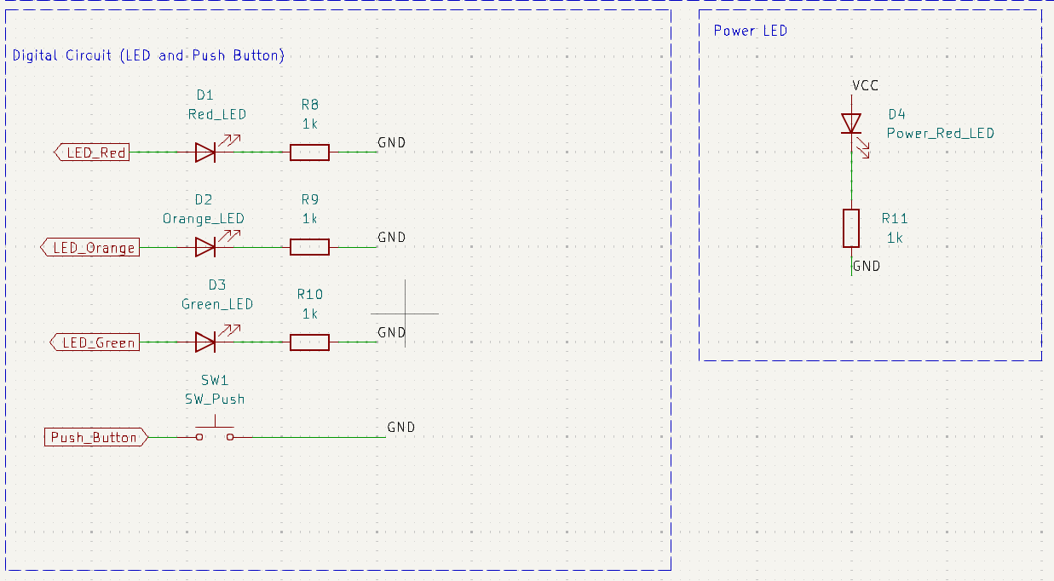
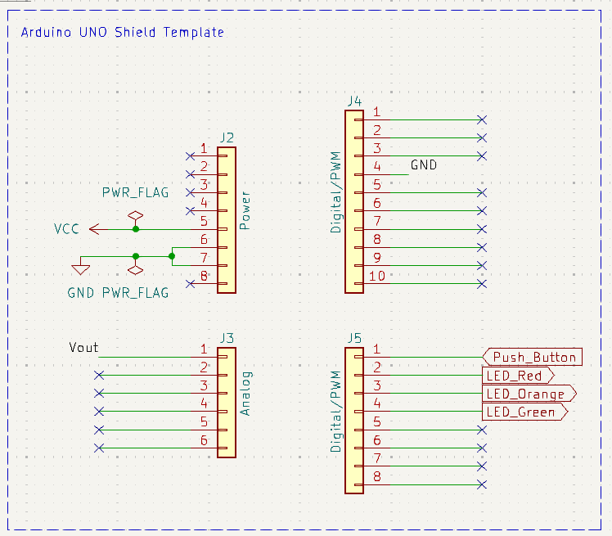
Lab01-02 (Hardware)

Slide 6
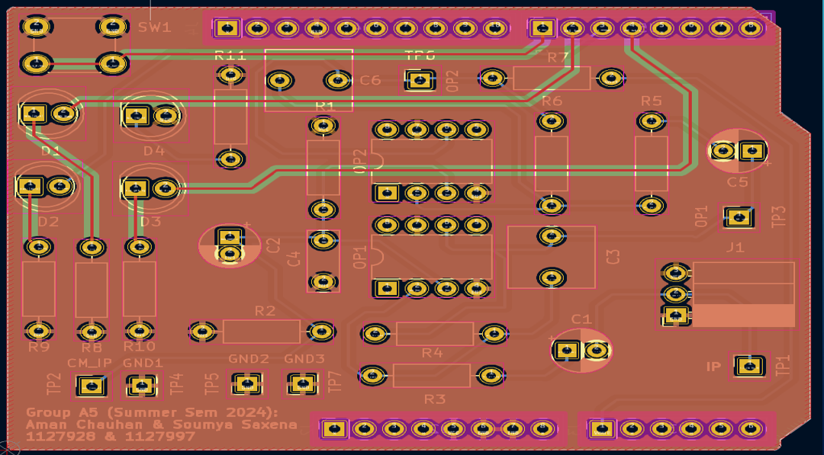
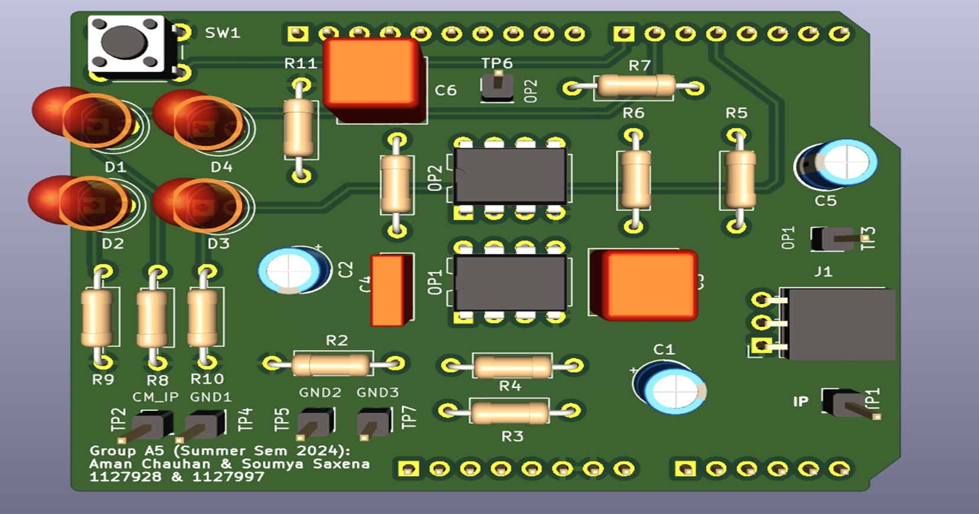
Lab01-02 (Hardware)

Slide 7
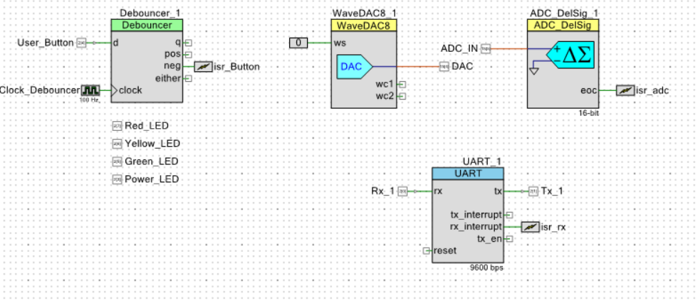
Lab03-04 (PSOC TestBench)
Digital Input and Output Circuit for User Button and LED
Debouncer to nullify Push Button debouncing effect
Interrupt to set the flag

Slide 8
Lab03-04 (PSOC TestBench)
Wave Function Generator (Sine/Triangular) depending on input to waveselect pin(ws = 0/1)
DAC Output feed to Voltage Divider Circuit

Slide 9
Lab03-04 (PSOC TestBench)
Read the Analog output of the Voltage divider and Bandpass filter circuit and will sample according to the state machine

Slide 10
Lab03-04 (PSOC TestBench)
Communication between PSOC 5 board and MATLAB

Slide 11
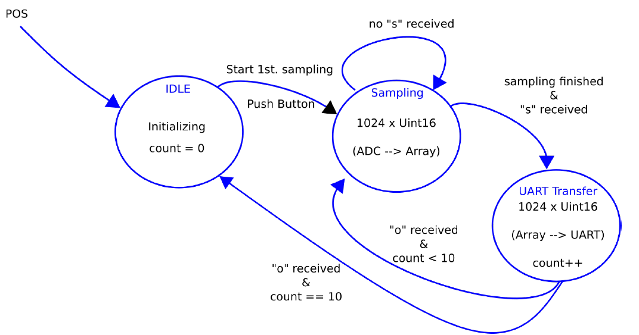
Lab03-04 (State Machine)

Slide 12
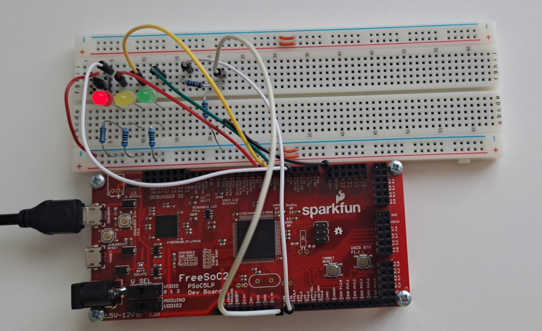
Idle State

Slide 13
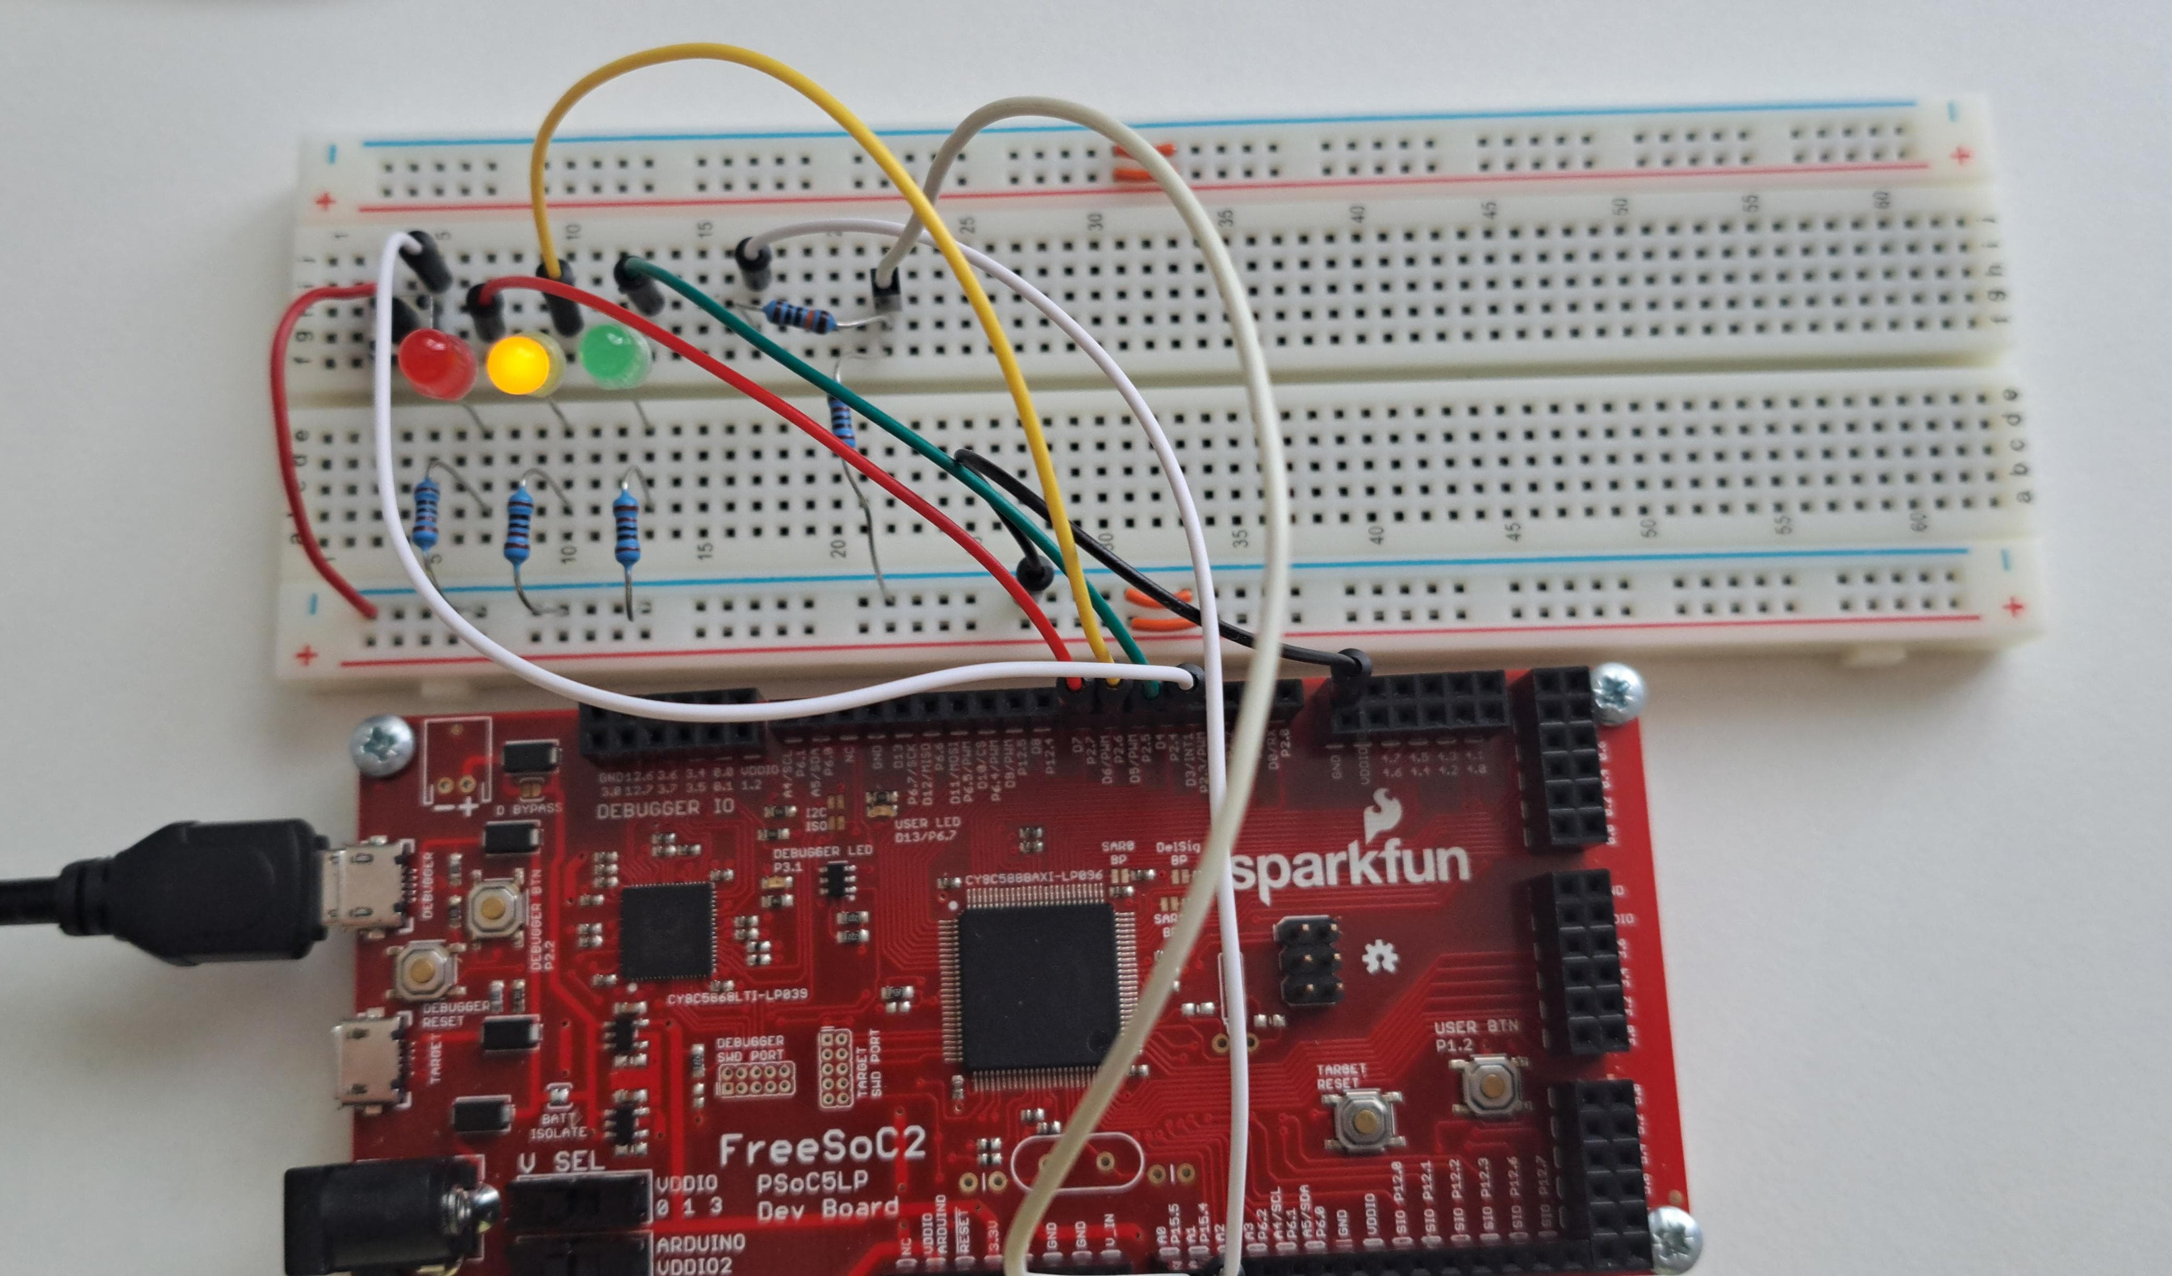
Sampling State

Slide 14
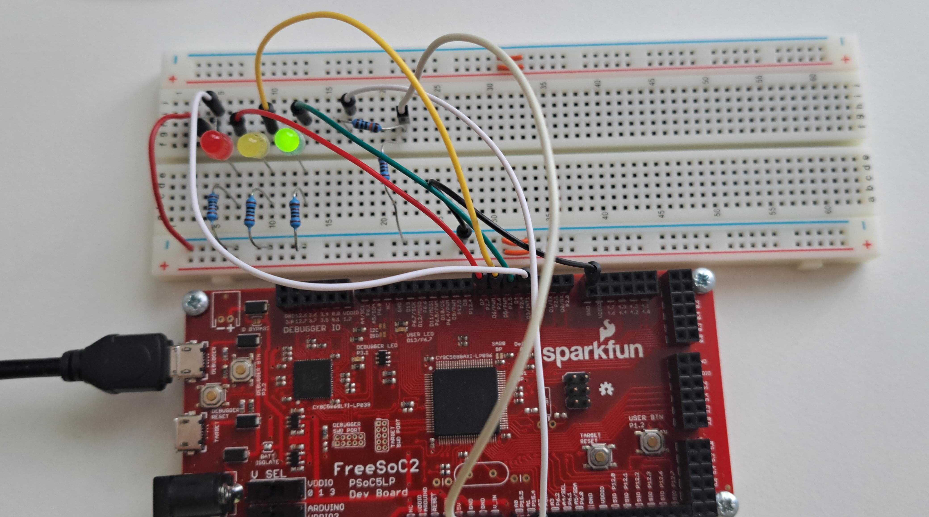
Transfer State

Slide 15
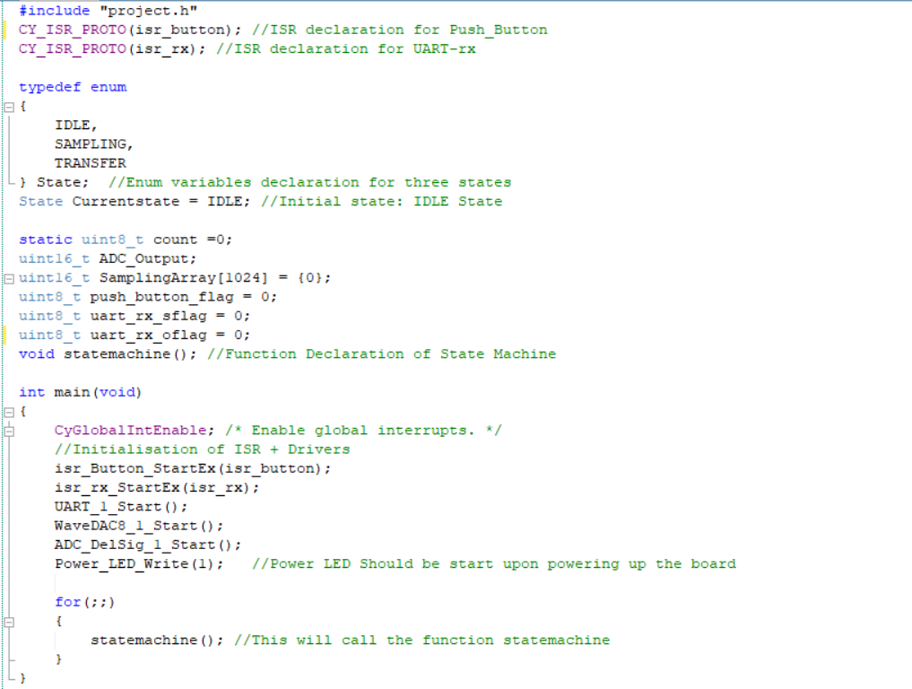
Lab03-04 (Software)
ENUM Declaration for Different States
Function, Variables & ISR Declaration

Slide 16
Lab03-04 (Software)
In Main: Driver Initialization and calling State Machine Function
Inside infinite loop

Slide 17
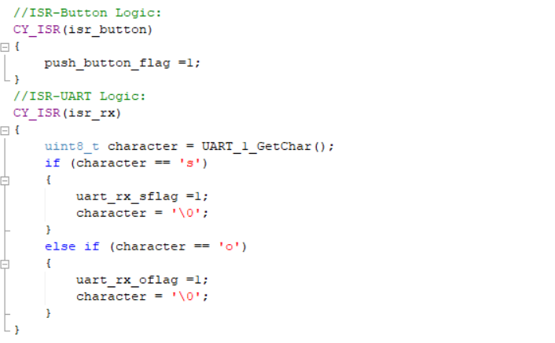
Lab03-04 (Software)
In Button ISR: Button Pressed, Flag is set

Slide 18
Lab03-04 (Software)
In UART ISR: sflag and oflag is set depending on the character
Received from MATLAB via UART

Slide 19
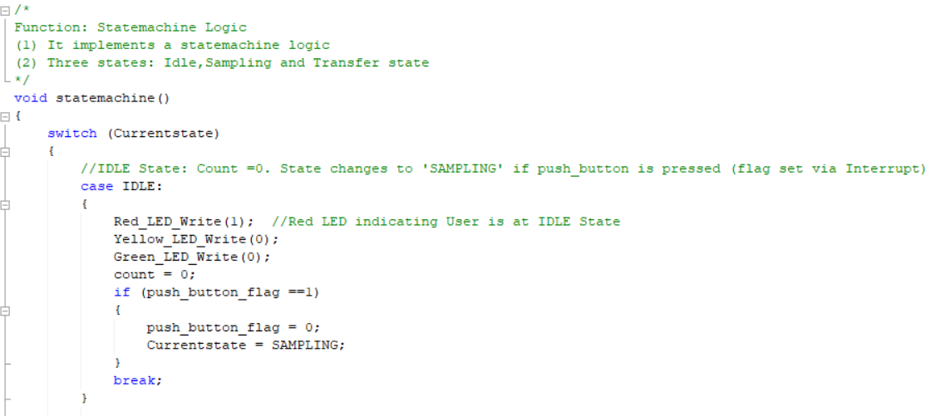
Lab03-04 (Software)
RED Led glow showing IDLE State is currently executed
Count initialized to 0
Check push_button_flag set via ISR
Reset the flag
Switch to next state

Slide 20
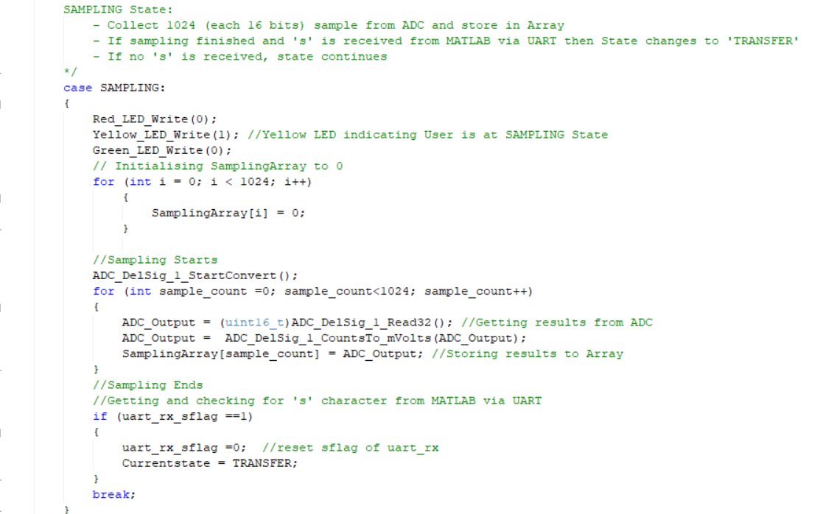
Lab03-04 (Software)
Yellow Led glow showing Sampling State is currently executed
Array initialized to 0
Read 1024 samples from ADC to Array
Check sflag is received
Clear the flag
Move to next state

Slide 21
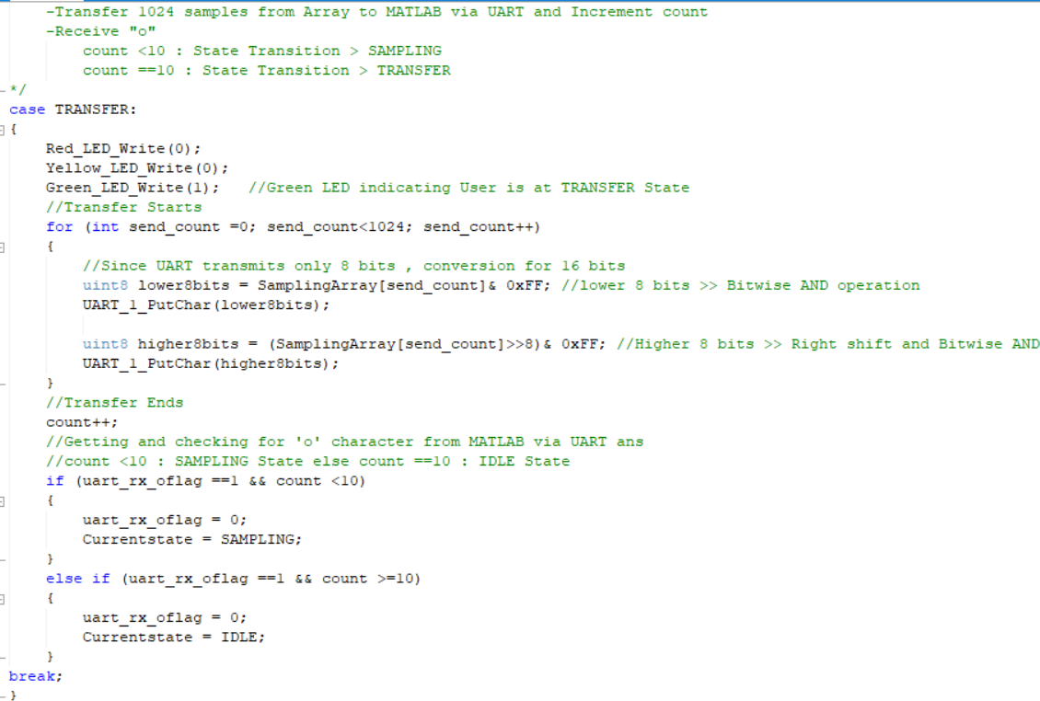
Lab03-04 (Software)
Green Led glow showing Transfer State is currently executed
Read 1024 samples from Array to UART
Increment Count
Check oflag is received and count <10, clear flag and move to Sampling State
Check oflag is received and count >=10, clear flag and move to Idle State

Slide 22
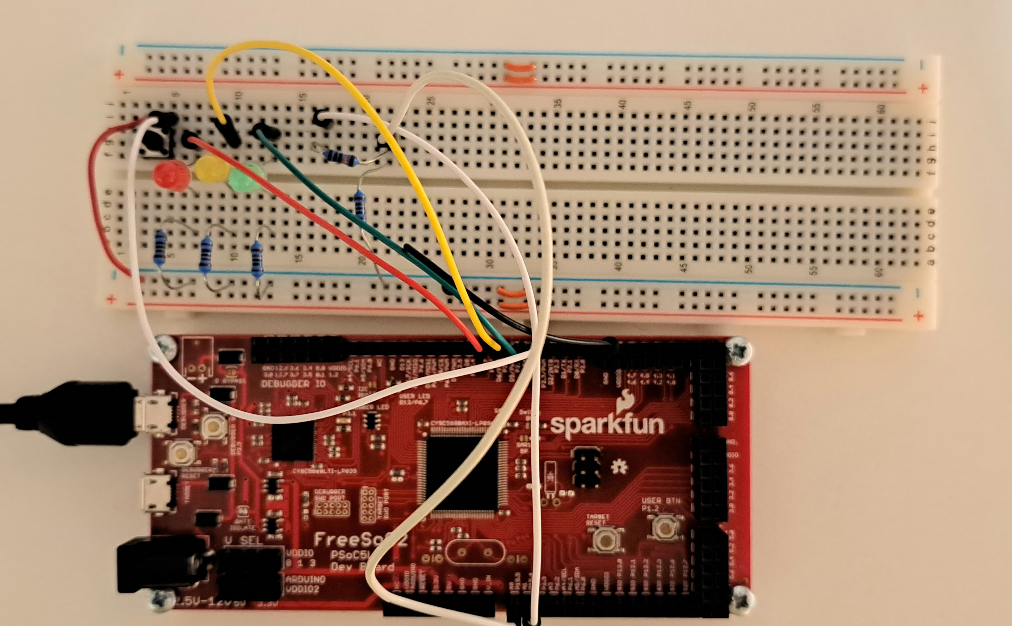
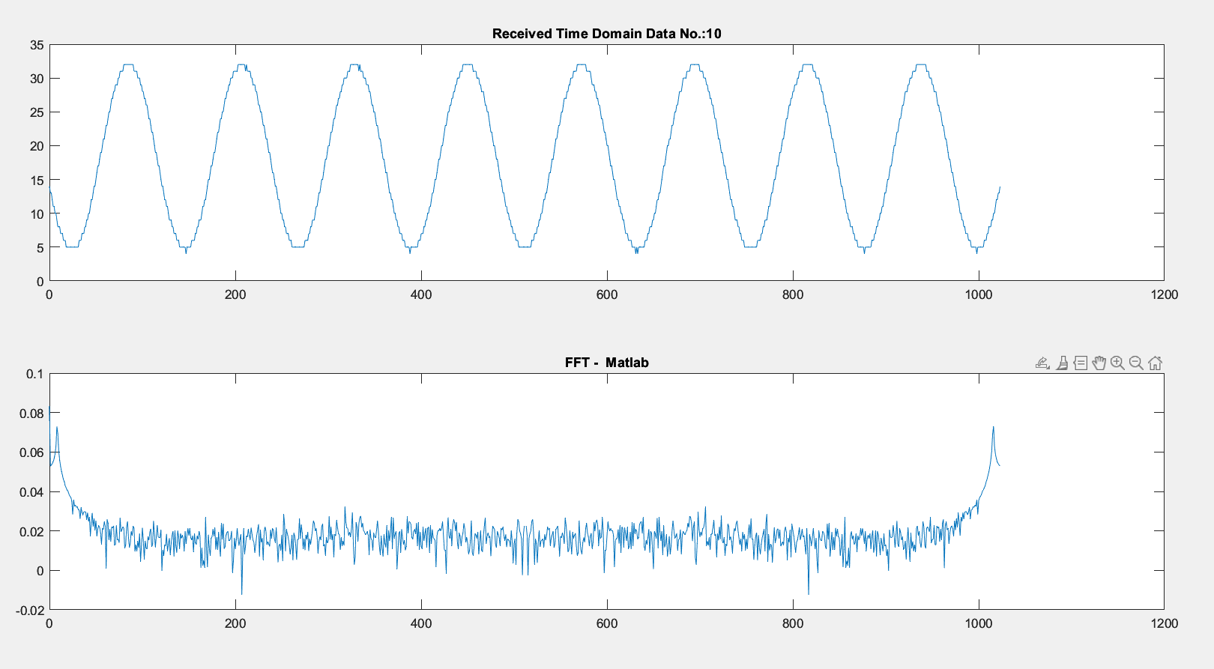
Lab03-04 (Output)
R1 = 100k, R2 = 1k
Input Signal Amplitude (p-p) = 3v Output of Voltage Divider = 3/(100+1) ≈ 3mv

Slide 23
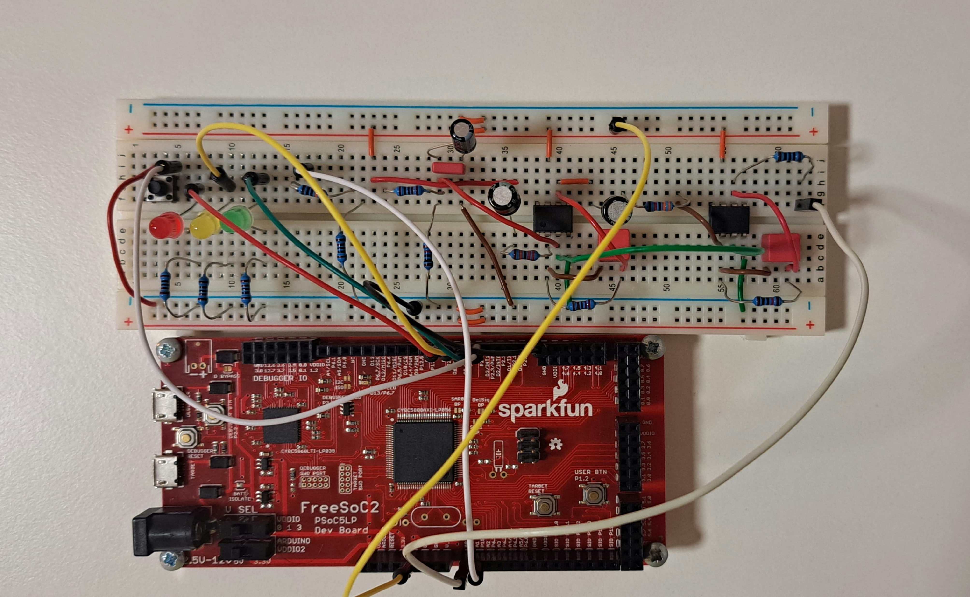
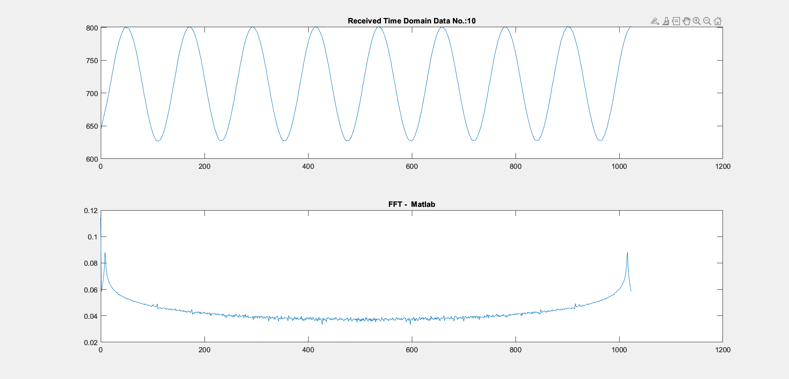
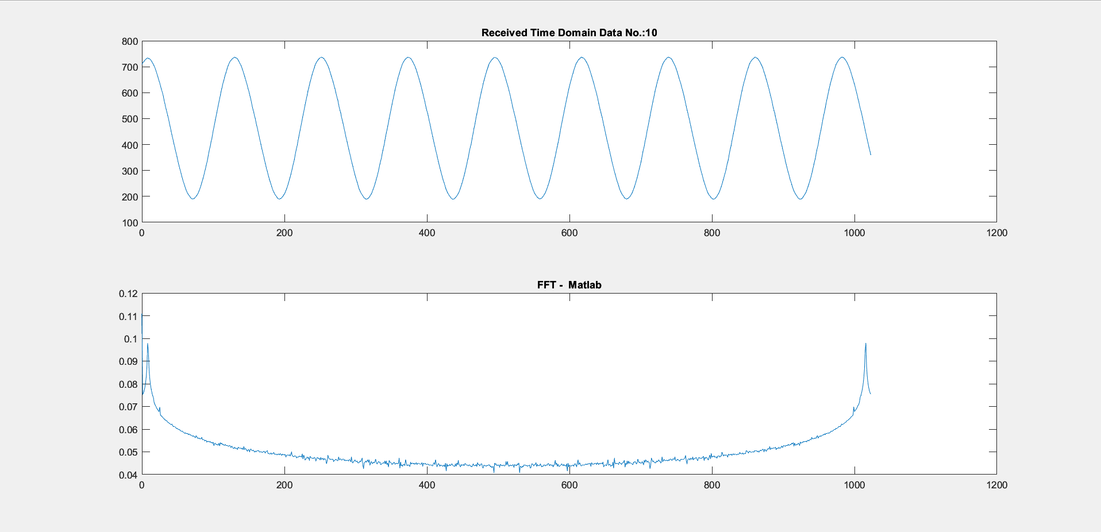
Lab03-04 (Output)
R1 = 100k, R2 = 1k
Input Signal Amplitude (p-p) = 3v Output of Voltage Divider = 3/(100+1) ≈ 3mv
Gain of both stage = 100*3 = 300
Output = 3mv * 300
Output of 2nd Stage
Output of 1st Stage

Slide 24
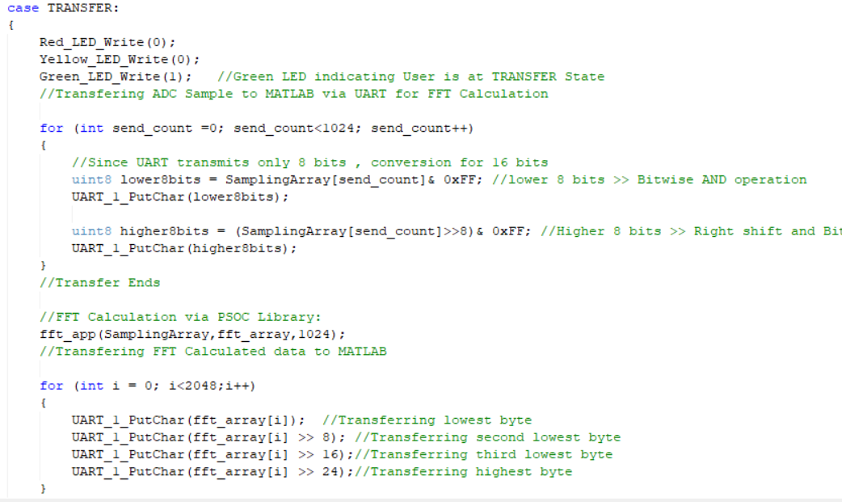
Lab05 (FFT Analysis)
Defining FFT library, Number of samples and FFT Output Array which stores (Number of samples)*2 samples
In Transfer State, using fft_app API to do FFT Calculation and storing result in Output Array
Sending 2048 samples of FFT Output Array to MATLAB

Slide 25
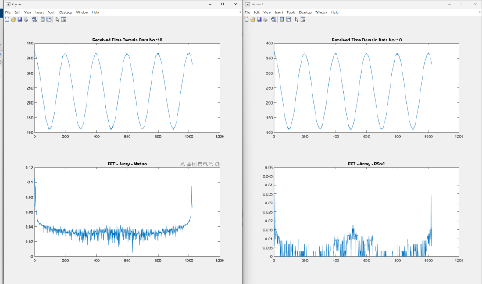
Lab05 (FFT Analysis)
In Testbench we are displaying the Output of FFT Result from PSOC and from MATLAB

Slide 26
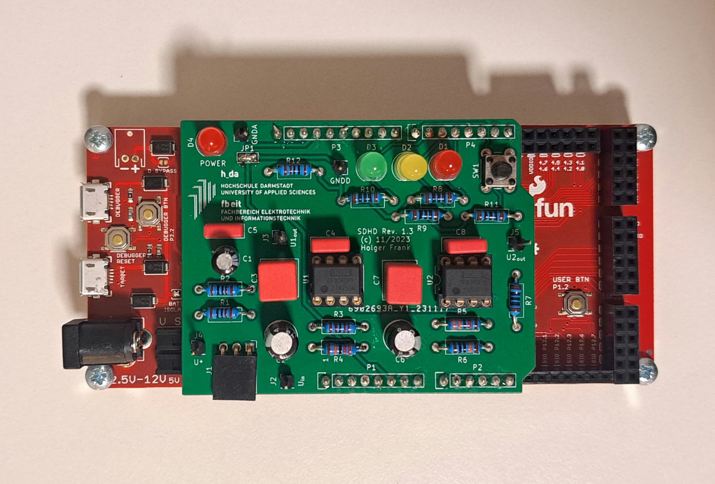
Lab06 (Soldering of PCB)

Slide 27
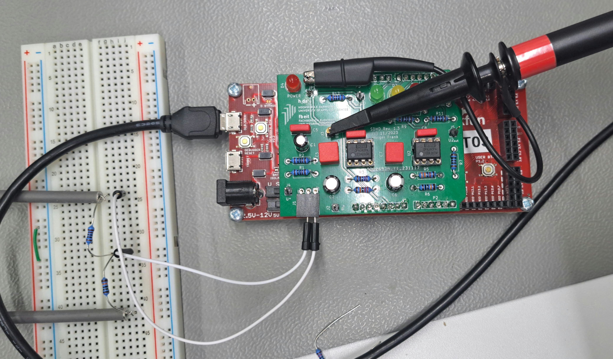
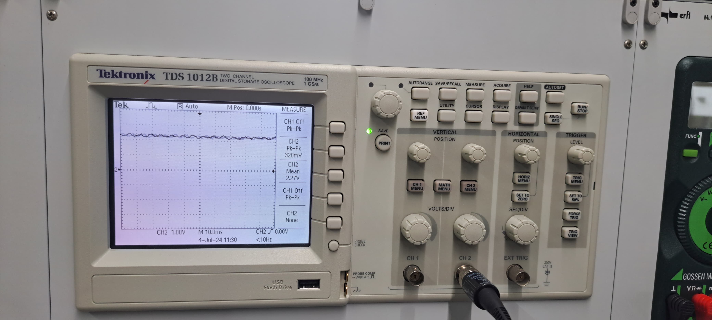
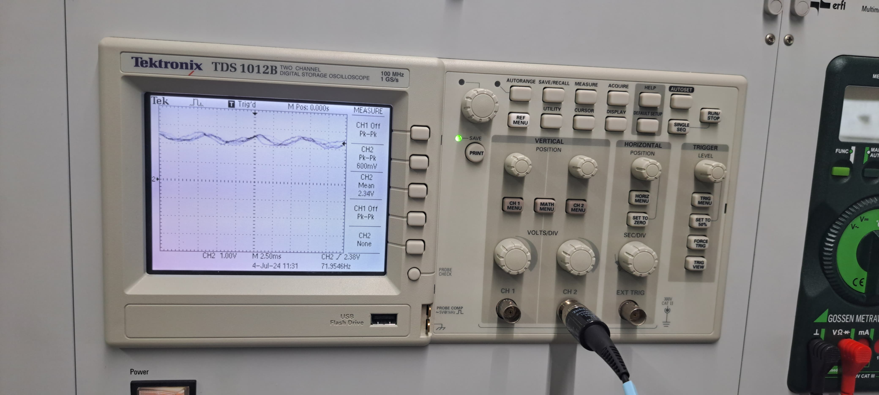
Lab06 (PCB Testing)

Slide 28
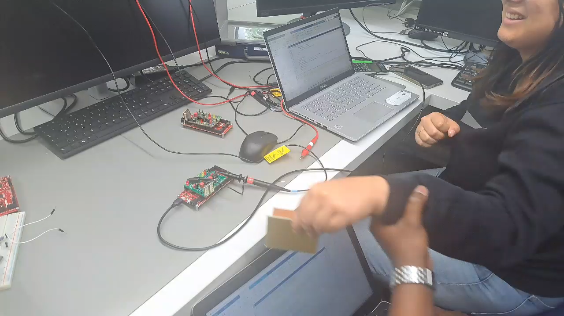
Lab06 (RADAR Testing)

Slide 29
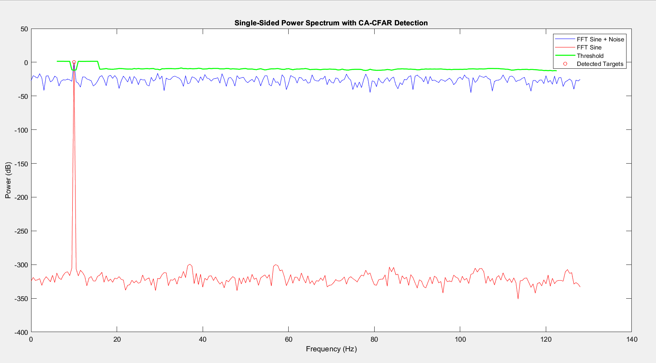
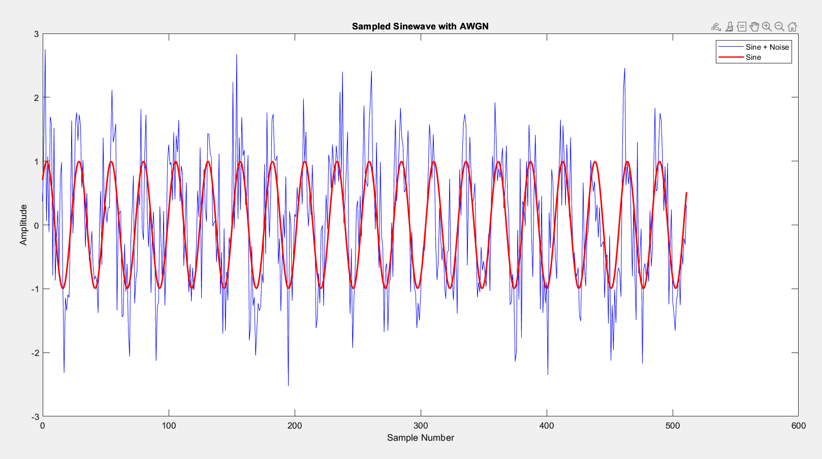
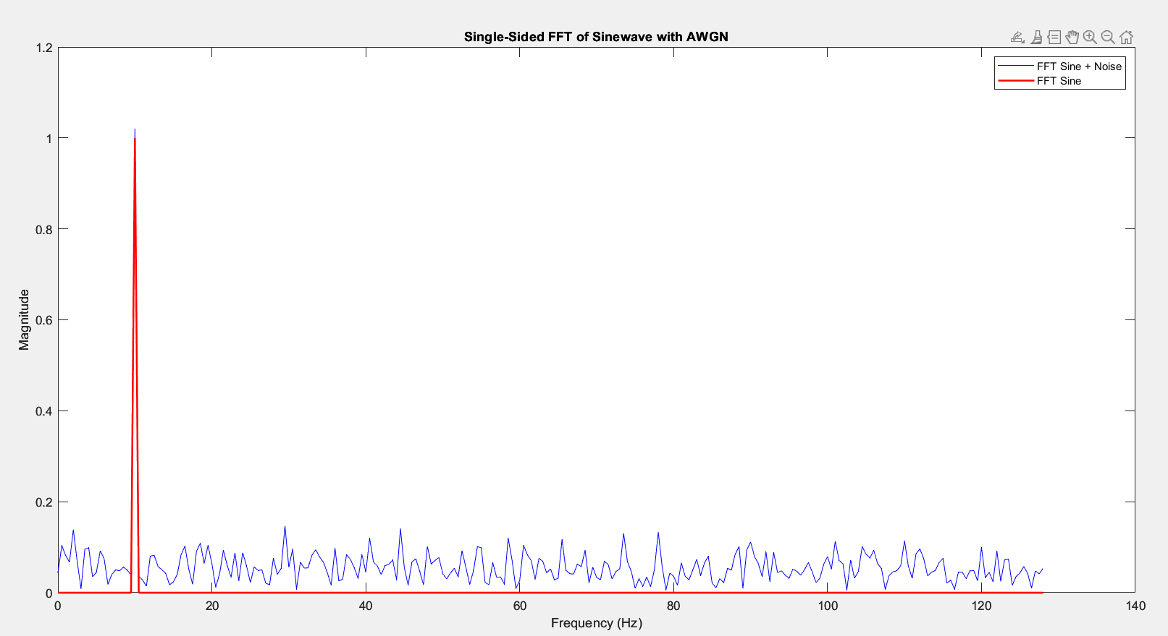
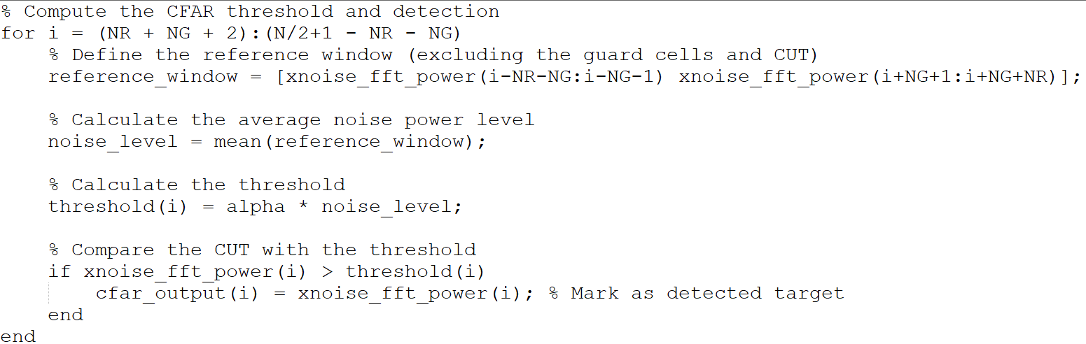
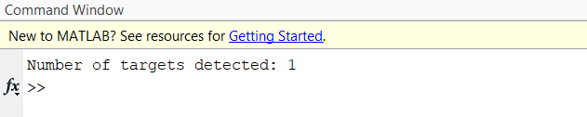
Lab06 CFAR Implementation
With Sample Sine Wave and AWGN:

